Slide 1
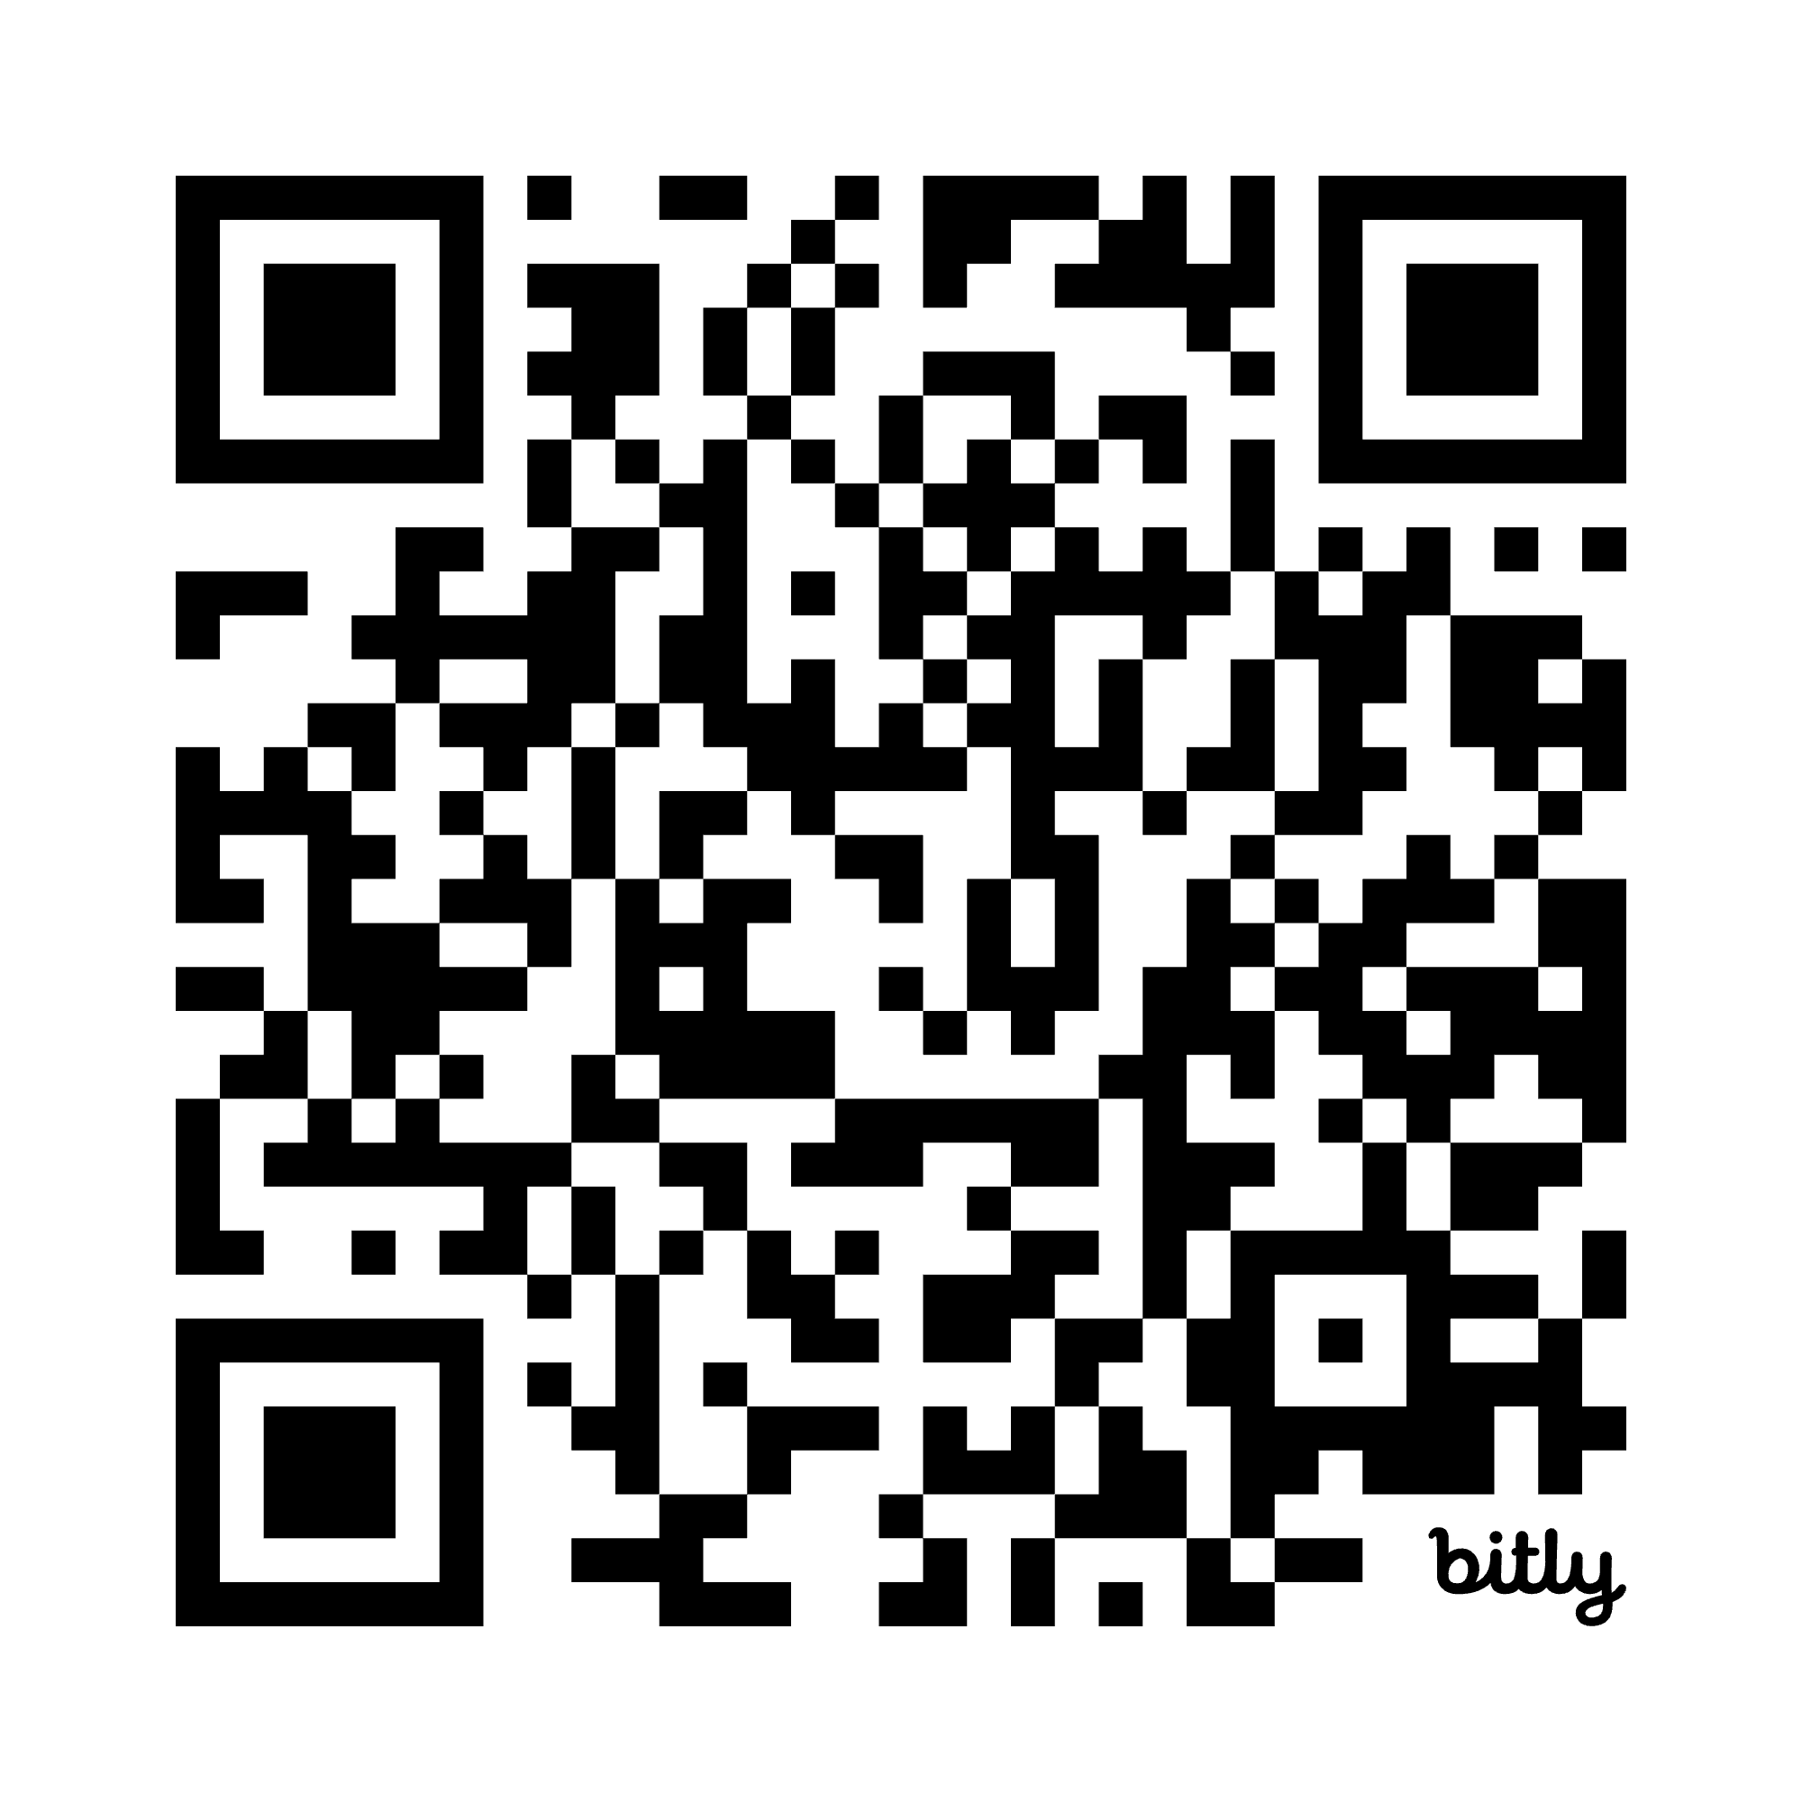
Finding Funding and Managing Uncertainty
Slides/links at https://bit.ly/CDIFunding

Slide 2
Plan for today
Walk through current NIH funding pathways
Finding non-NIH mechanisms to support research

Slide 3
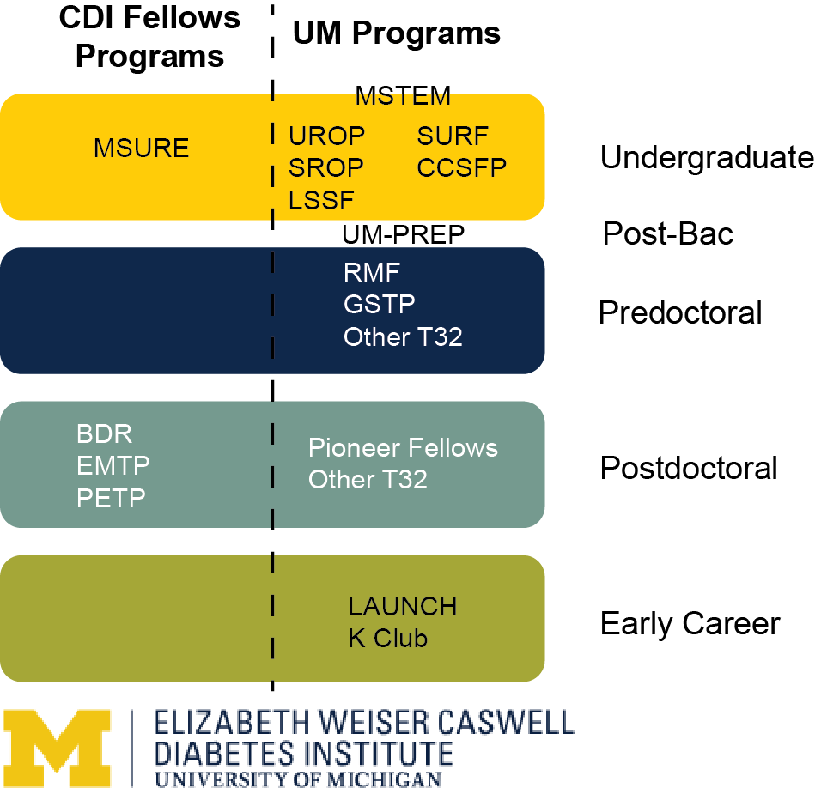
Entry Points to Diabetes Research

Slide 4
Some Types of Funding
 | Controlled by | Generally Covers
Mentor Based Funding or GSRAs | Mentor | Research costs, stipends
Fellowships (e.g. F/K awards) | Trainee | Stipend, benefits, career development,
Training Grants (e.g. T32) | Program Director | Set number of trainee slots, salary and training plan
Research Grants | Trainee | Research costs, stipends
Grad Student Instructors (predoc) | Department | Stipend, but involves teaching

Slide 5
Fellowship Advantages
May be portable
Uniquely identifiable to you – track record
Often includes training components, including career development

Slide 6
Fellowships and Training Programs (NIH)

Slide 7
Other NIH Fellowship Programs

Slide 8
Award Eligibility
Fellowship | Citizenship | Stage
F31 | US Citizen or Permanent Resident | PhD Program, Candidate when awarded
F32 | US Citizen or Permanent Resident | Postdoc (PhD when awarded)
K01 | US Citizen or Permanent Resident | Postdoc (2-6 years)
K08 | US Citizen or Permanent Resident | Clinical Postdoc (2-6 years)
K23 | US Citizen or Permanent Resident | Clinical Postdoc (2-6 years)
K99 | Any | Postdoc (1-4 years)

Slide 9
Training Grants (e.g. T32)
Programs or Groups apply (not individuals)
Can be predoctoral or postdoctoral,
Can be clinical or basic science
Dedicated number of slots, allocated by the program
Involves Training Program and Trainee Support
Restricted to US Citizens and Permanent Residents

Slide 10
Training Grants at Michigan
Michigan has 59 separate T32s
242 predoctoral trainee slots
132 postdoctoral trainee slots
Some examples of T32s at Michigan
Multidisciplinary Training Program in Basic Diabetes Research (5 postdoc - basic)
Developmental Origins of Metabolic Disorders (3 postdoc - clinical)
Training Program in Endocrinology and Metabolism (4 postdoc - clinical)
Obesity & Gastrointestinal Surgery Research Training Program (3 postdoc - clinical)
Training in Basic and Translational Digestive Sciences (3 predoc, 1 postdoc – basic)

Slide 11
What if I’m not eligible for T32/F31?
American Heart Association
Predoc and Postdoc fellowships (due early September)
Johns Hopkins Database of Trainee Funding
Predoc https://bit.ly/GradFundingOpps5725
Postdoc https://bit.ly/PostdocFundingOpps5725

Slide 12



Navigating Uncertainty
Durga Singer, MD, MA

Slide 13


Individual tips for dealing with uncertainty
Practice mindfulness
Focus on the present
Be aware of your responses/feelings
Routine/practice of self care
Delegation
Adjusting
Stay connected

Slide 14
Proactive tips for dealing with uncertainty
Challenge beliefs about uncertainty
Reflect on past successes
Make a plan B or C

Slide 15

Tips for dealing with uncertainty
Reframe your thoughts about uncertainty and focus on certainty
Focus on what you can control
Keep an eye on your vision
Focus on values
Ground yourself with who you are
Limit news and social media
Reflect the emotion you want your team to have

Slide 16
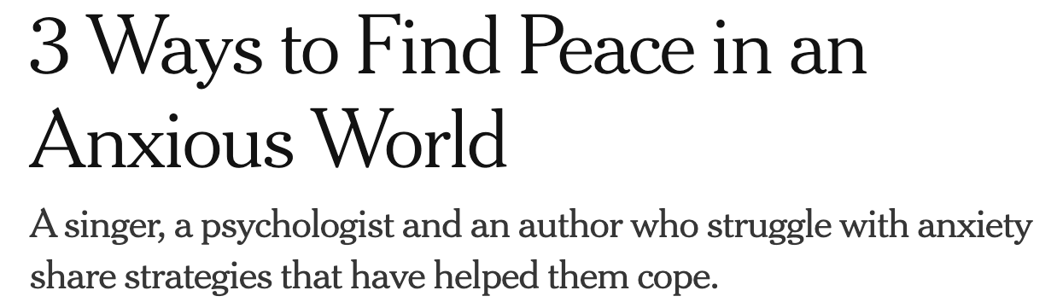
Focus on action
Be willing to experiment (to identify what works for you)
Cultivate mindfulness

Slide 17
What ideas do you have and what can CDI do?
Help pivoting grants?
Holding no agenda meeting
How to advocate productively.
Flexibility in funds use - salary restriction?
Provide updates as we learn them
Advocating for information about internal grants when unknown RPPR?

Slide 18
Slides and Links
OVPR’s Funding Database (Michigan Specific) - https://research.umich.edu/ovpr-find-funding/
Next month’s talk Giving a presentation (June 27th) B20, Rm 2814
Subscribe here to get the latest news, events and happenings.

